Slide 1


Capgemini Training
Cse441
Presented By:
Gurubelli Vikram
11613655

Slide 2
Introduction
Capgemini is a French multinational management consulting corporation headquartered in Paris, France.
It is one of the world's largest consulting, technology and outsourcing companies with 180,000 employees in over 40 countries.
It was founded in 1967 by Serge Kampf in Grenoble, France. The company has been led by Paul Hermelin, the chairman and CEO of the Capgemini group, ever since his appointment in December 2001.

Slide 3
Capgemini India
Capgemini India was established in 2001 with its first office in Mumbai with 250 engineers. In 2004, it started its first BPO operation centre at Bangalore with 200 employees. Later, It started its LBS(Local Business Services) to server Indian market in 2008.
Capgemini in India is over 85,000 people strong across nine cities
(Mumbai, Bangalore, Gurgaon, Noida, Gandhinagar, Hyderabad, Pune, Kolkata and Chennai).
A pioneer in the IT industry, it is collaborating with leading corporations and
now brings its Consulting, Technology and Outsourcing experience to India.

Slide 4
Capgemini India
Capgemini has strong domain experience to assist clients across the
Government and Public Sector, Energy and Utilities, Manufacturing, Telecom and Financial Services sectors.
It has a functional Centre of Excellences in Testing, Insights & Data, Mobile, Digital Customer Experience and Captives.
With a strong focus on quality, Capgemini India is CMMI SVC Level 5,
ISO 9001:2008, ISO 20000:2011 and ISO 27000 certified.
It follows a stringent delivery mechanism that involves Standardised Processes, and Quality and Risk Management.

Slide 5
Vision and Mission
VISION
The motto is People matter and result count.
The business value of a technology comes from and through people.
MISSION
With you we create and deliver business and technology solutions that fit your needs and drive the result you want.
We use the ideology of targeting values, Mitigating risk, Pro optimizing Capabilities and Aligning the Organization.

Slide 6
Training & Project
During the In campus training first we were taught different technologies and after the full training was divided into different sprints.
During sprints we used to work on the assigned projects to work on, also time to time evaluation made us easy to maintain the good track of learning.
The project on which I worked on was Flight Management System. It was team project, a team of four members was assigned and I was the TL for the project.

Slide 7
About The Project
Flight Management System Project
Objectives of the work undertaken
To develop a management system for the Flights and Airports and to handle their schedule.
Scope of the Work
This project is aimed at developing Flight Management System for admin and user. This is a web-based application that can be accessed throughout the web. This system can be used for
adding flight, updating flight, adding airport, scheduling flight, booking ticket etc.

Slide 8
About The Project
Importance and Applicability
The projects basically works as a management for the Flights and Airports as it can store all the details of which flight is taking off to which airport at which time and how many seats are available for booking.
Role and profile
In the project we were working with a team of four members and everyone was assigned different parts to work. As I was also the TL in the team my role was enhanced as I need to maintain the progress and work culture during the development of the project.
In the assigned project I was handling Scheduling in which I had to schedule a flight, view all scheduled flights, view flight, view schedule and search scheduled flight.

Slide 9
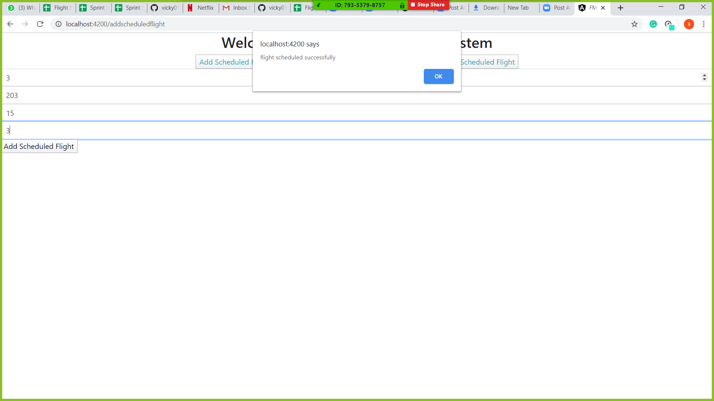

Slide 10
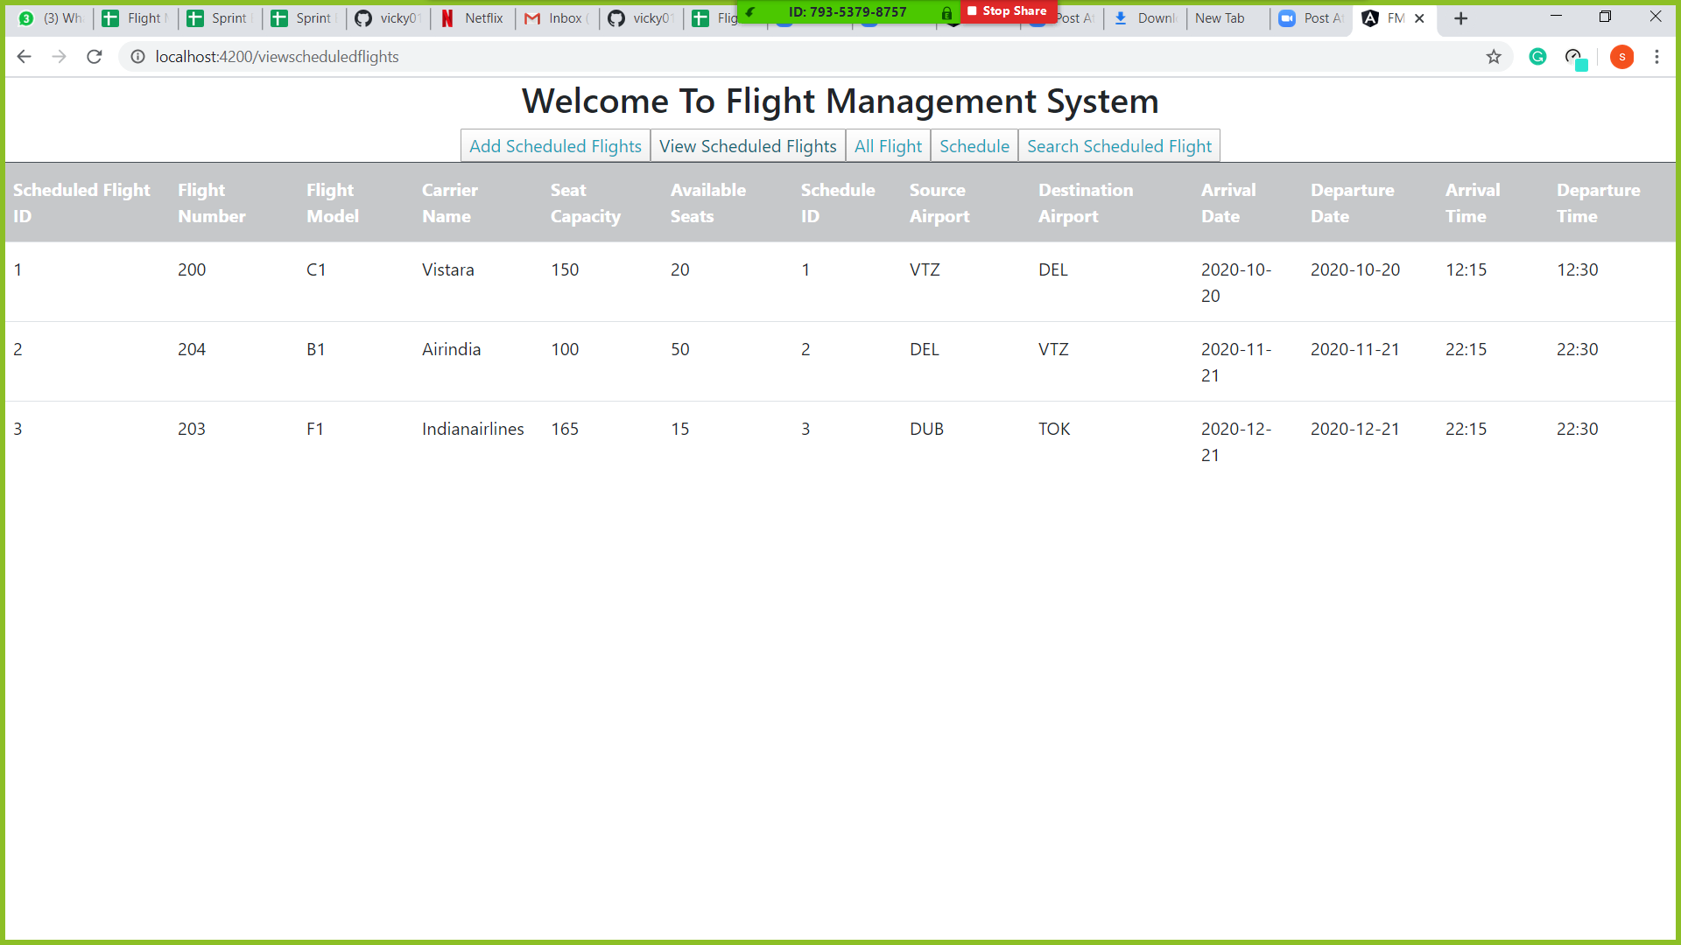

Slide 11
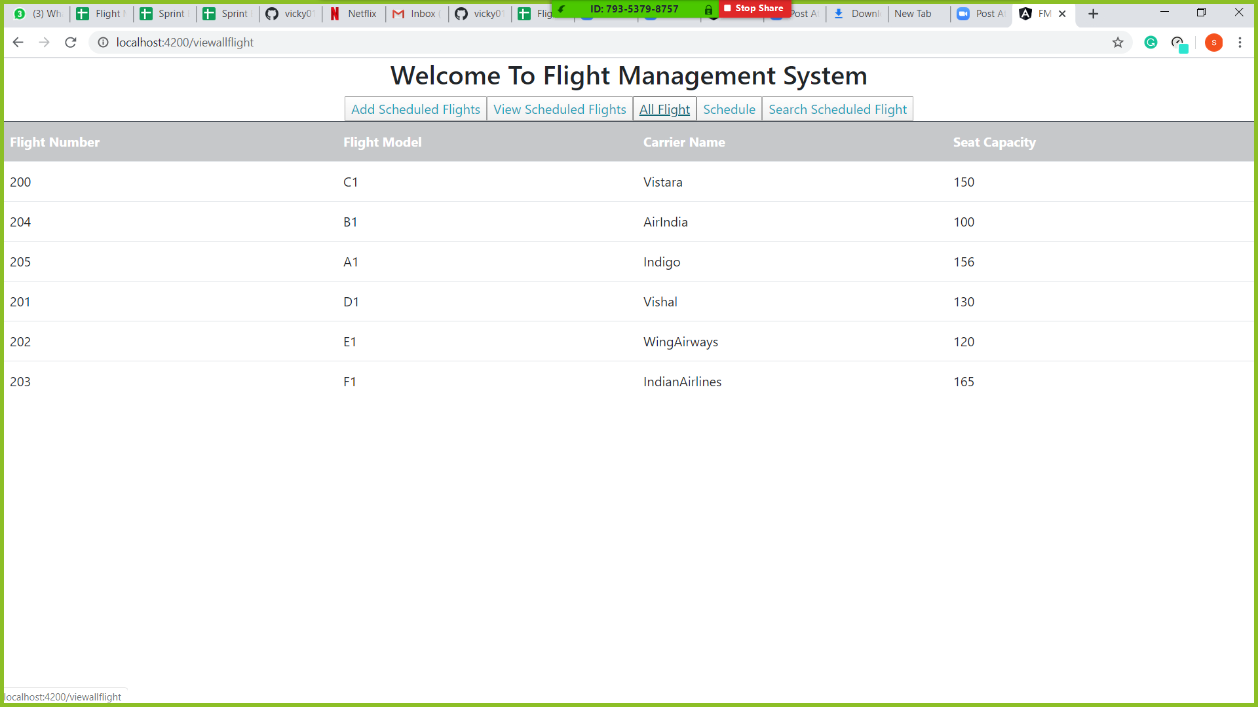

Slide 12
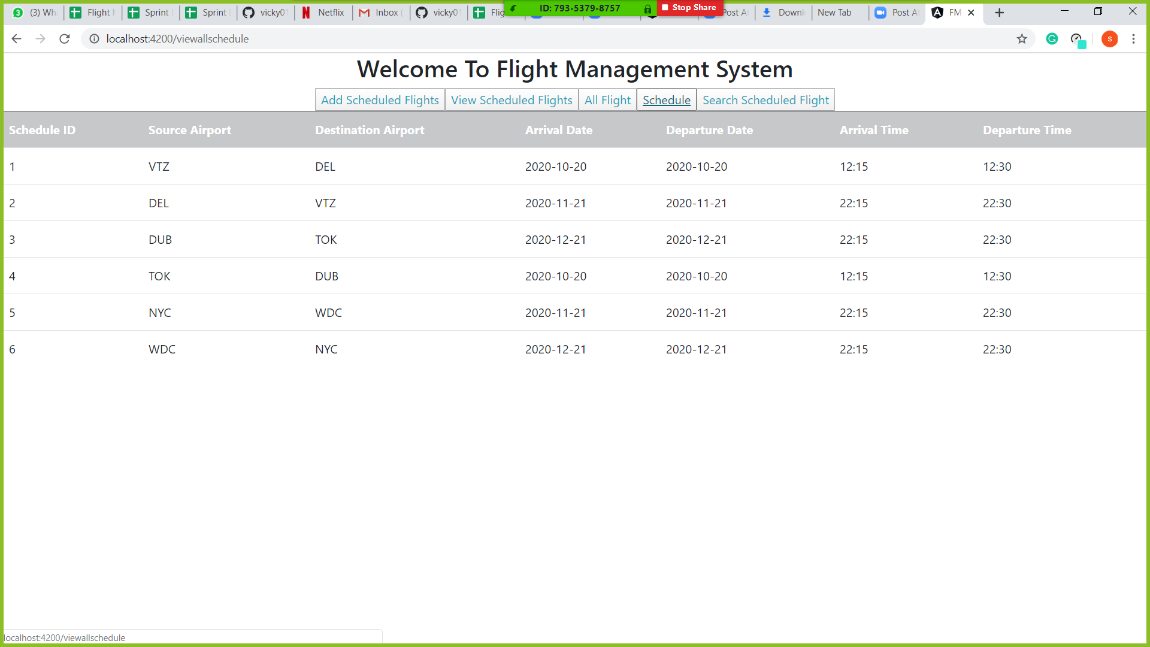

Slide 13
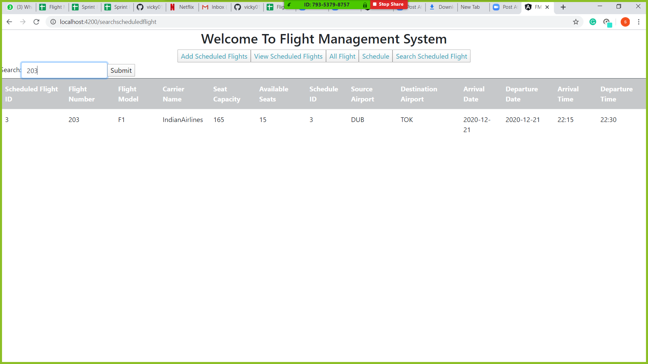

Slide 14
Outcome of the Training
My Learnings
Technologies like core Java, angular 6, GitHub ,git, spring, spring boot, jdbc, html, CSS.
Functional programming in real word web or full stack development.
Writing code with cleanliness, consistency and extensibility.
To approach the problems professionally.
Attention to details

Slide 15
Thank you

